Slide 1
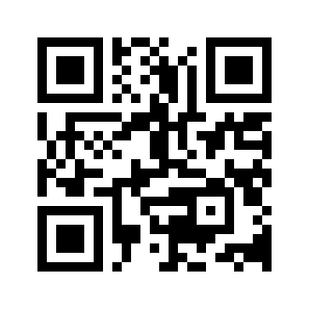

28 November 2025
debugging solidity
roman from walnut.dev

Slide 2
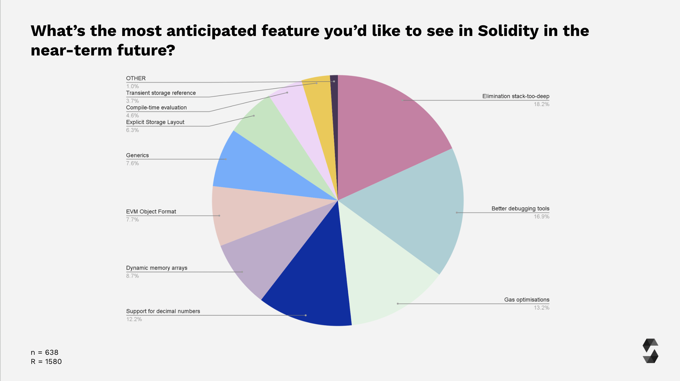

Solidity Developer Survey 2024 Results
Source: https://www.soliditylang.org/blog/2025/04/25/solidity-developer-survey-2024-results/

Slide 3
Agenda
Demo of the best Solidity Debugger with most amazing UX 💅
Challenges
Proposed Improvements

Slide 4
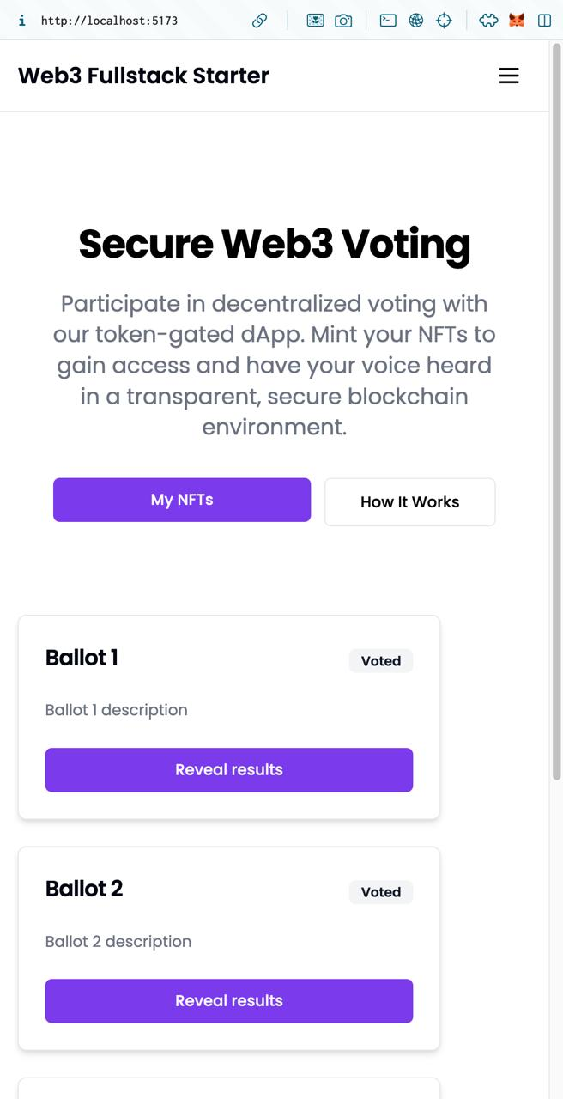
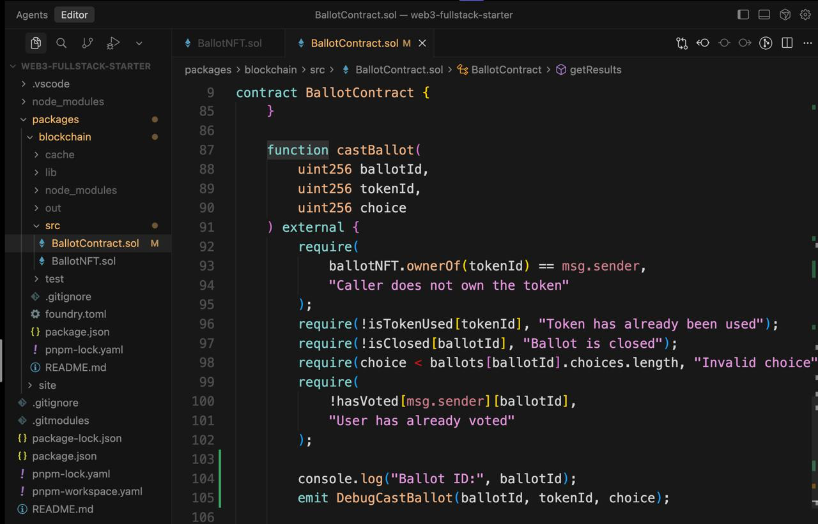
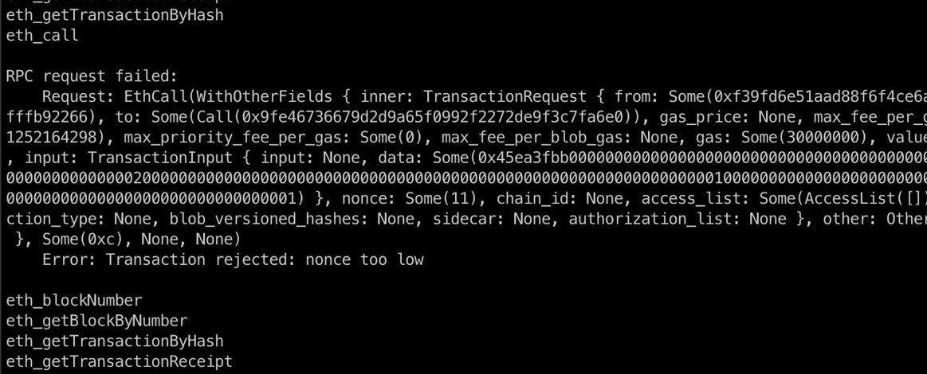

Slide 5
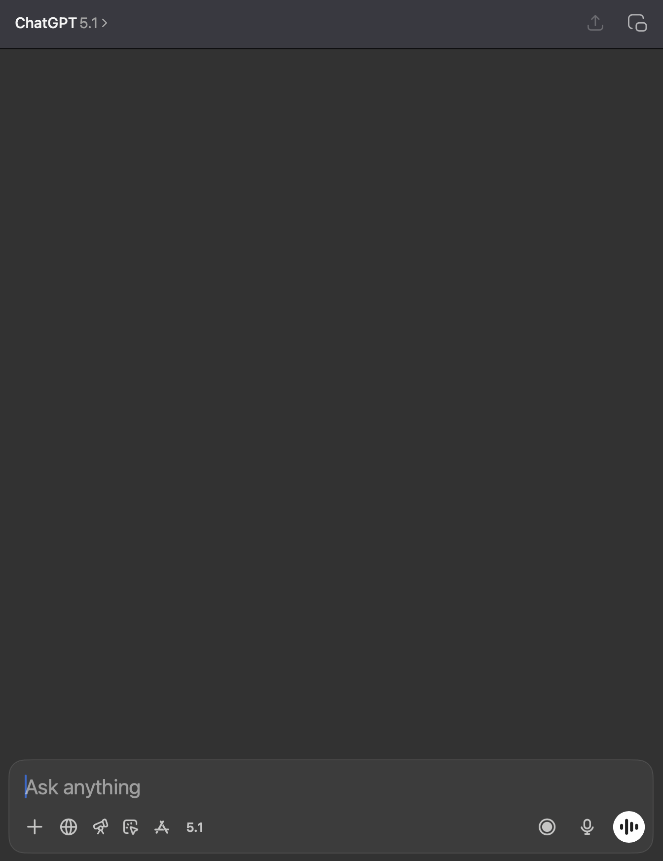

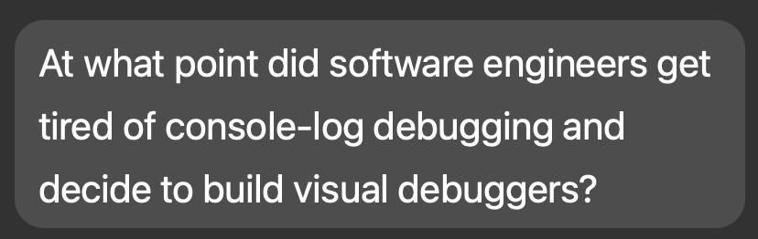
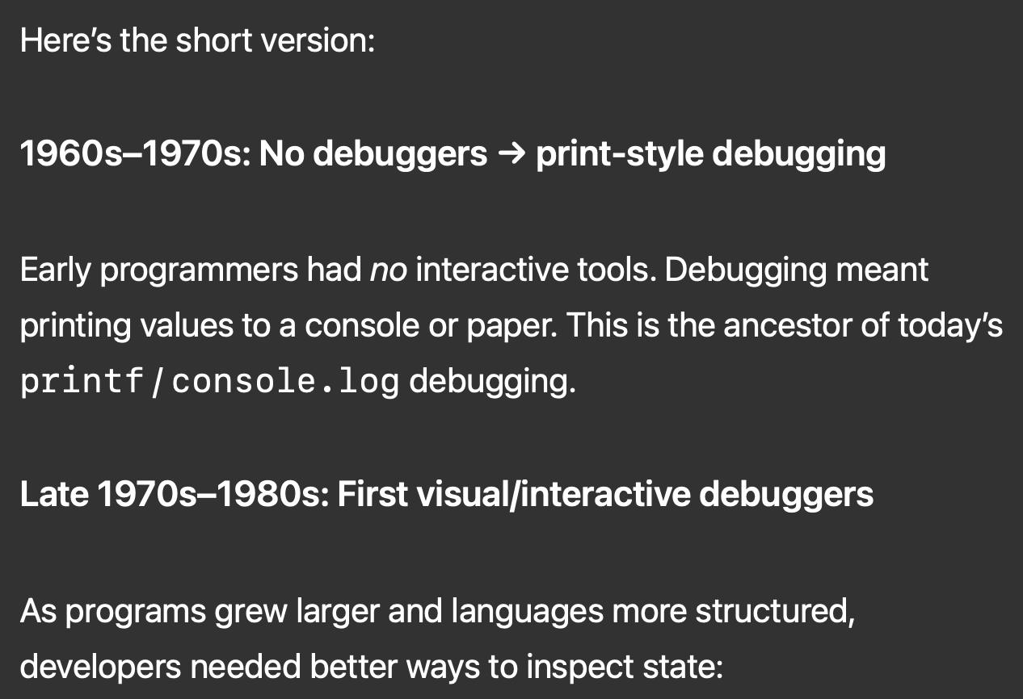

Slide 6
Demo:
The best Solidity Debugger with most amazing UX 💅

Slide 7
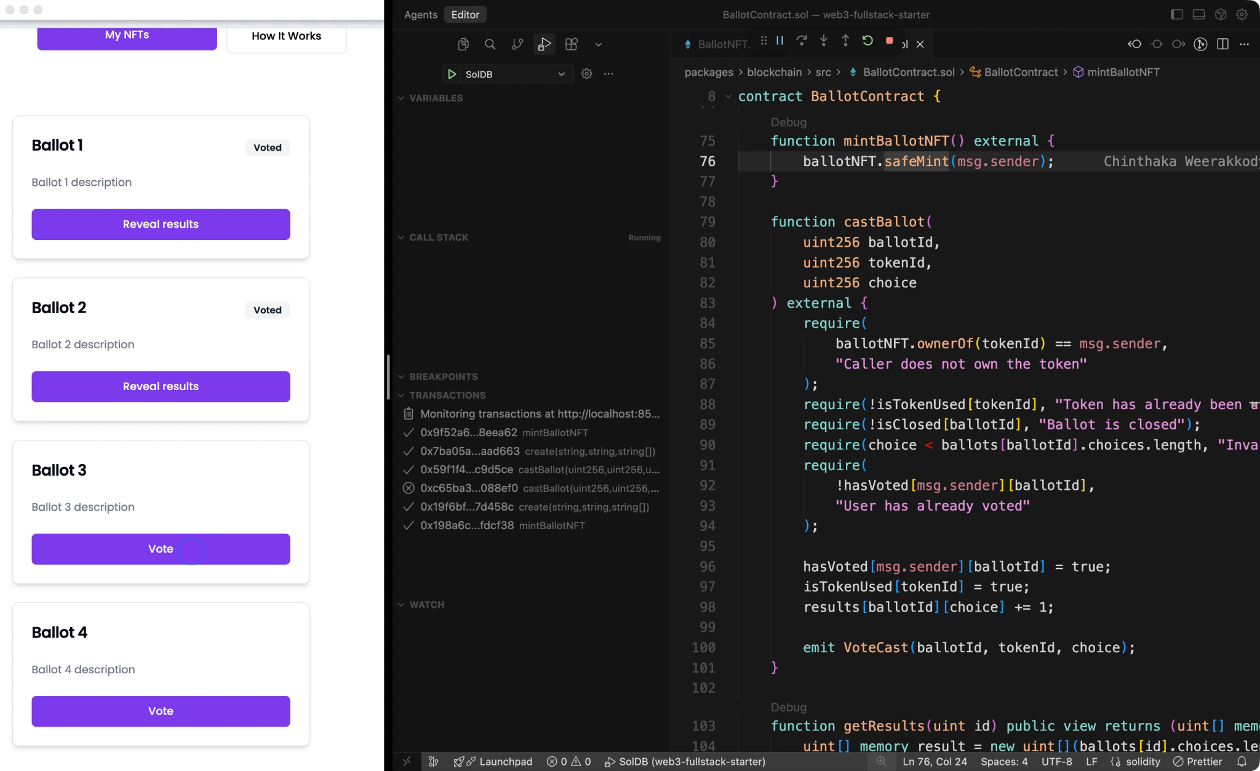

Slide 9
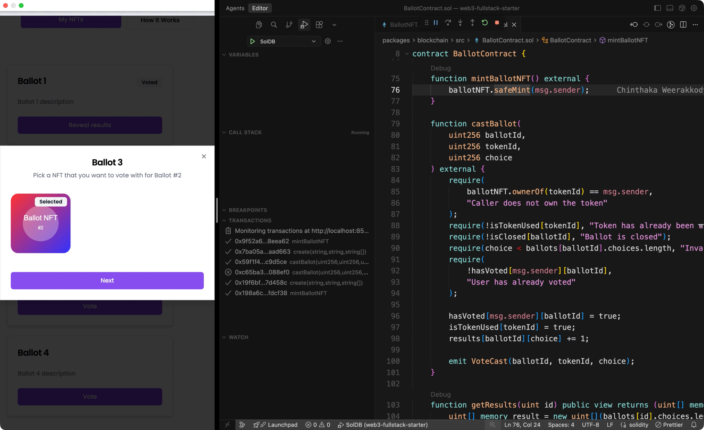

Slide 11
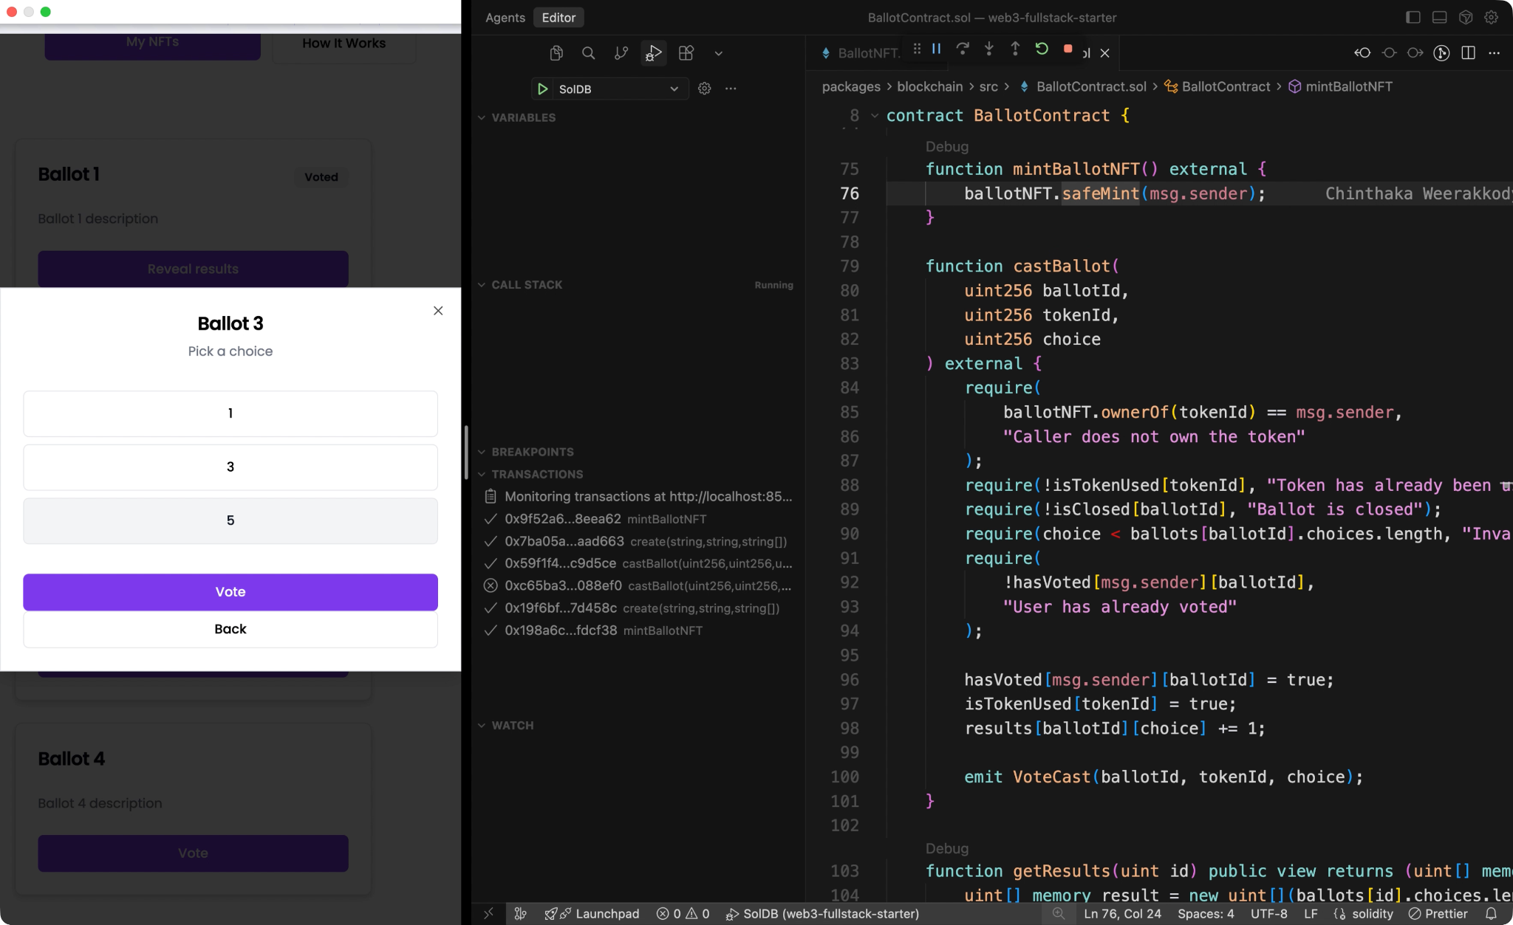

Slide 13
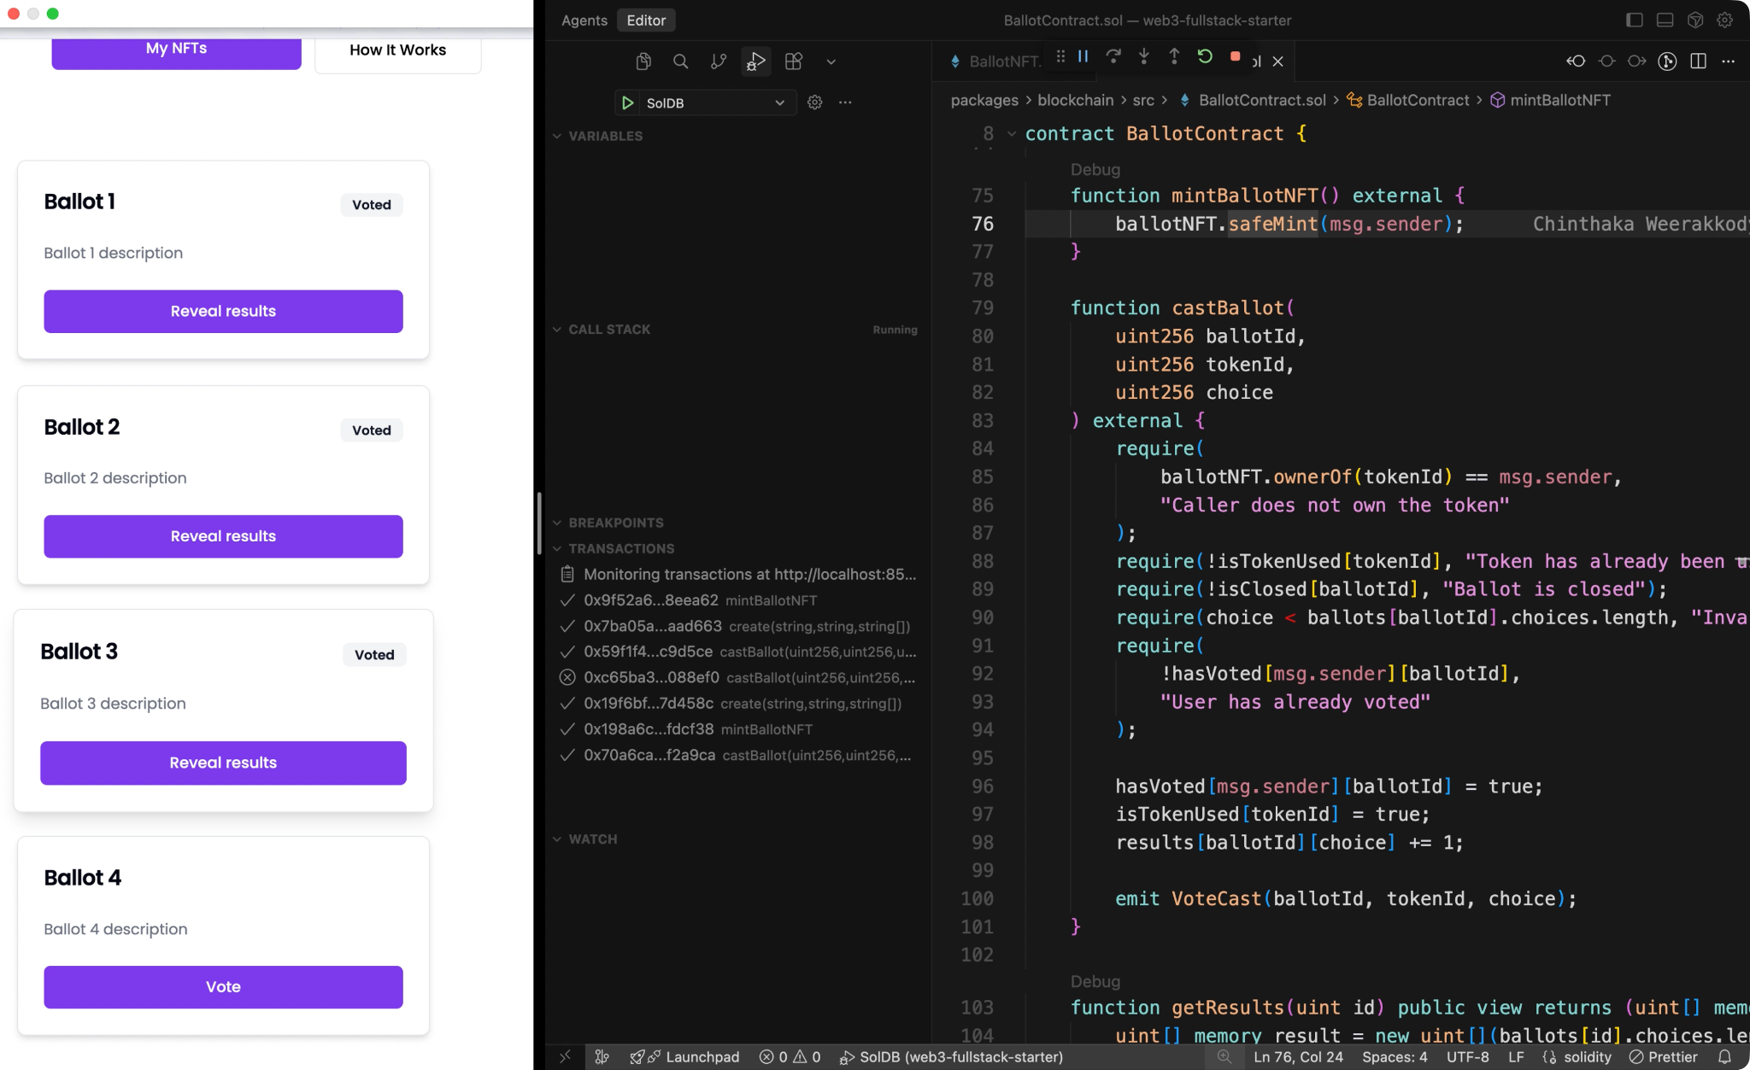

Slide 14


Slide 16
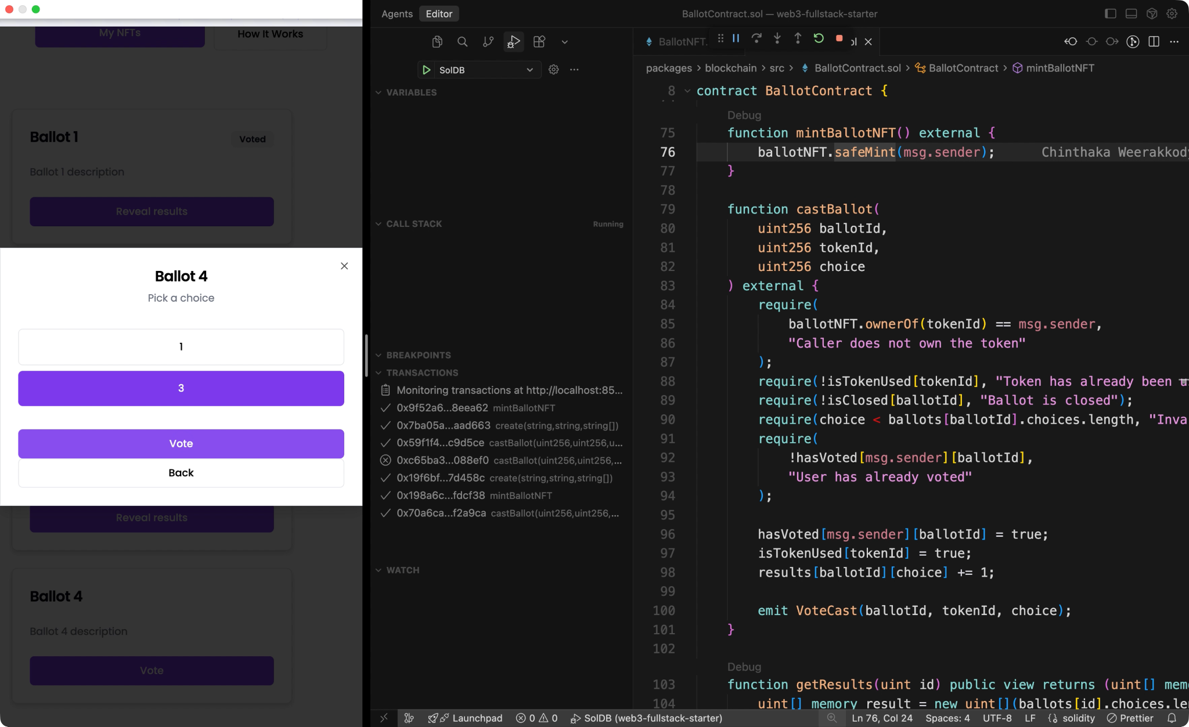

Slide 18
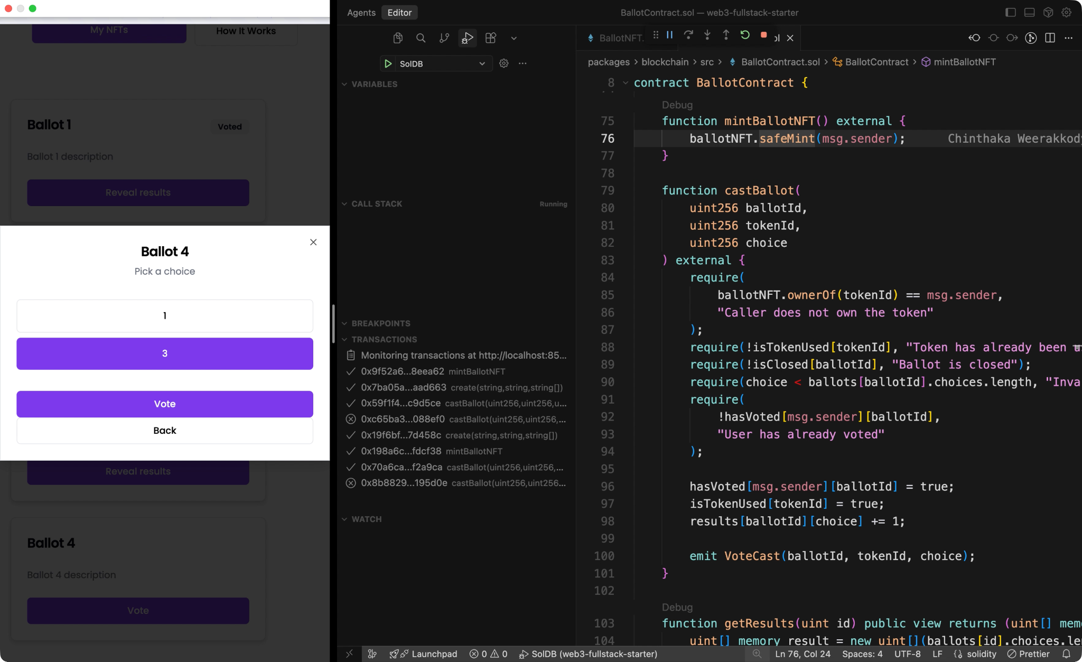

Slide 20


Slide 21
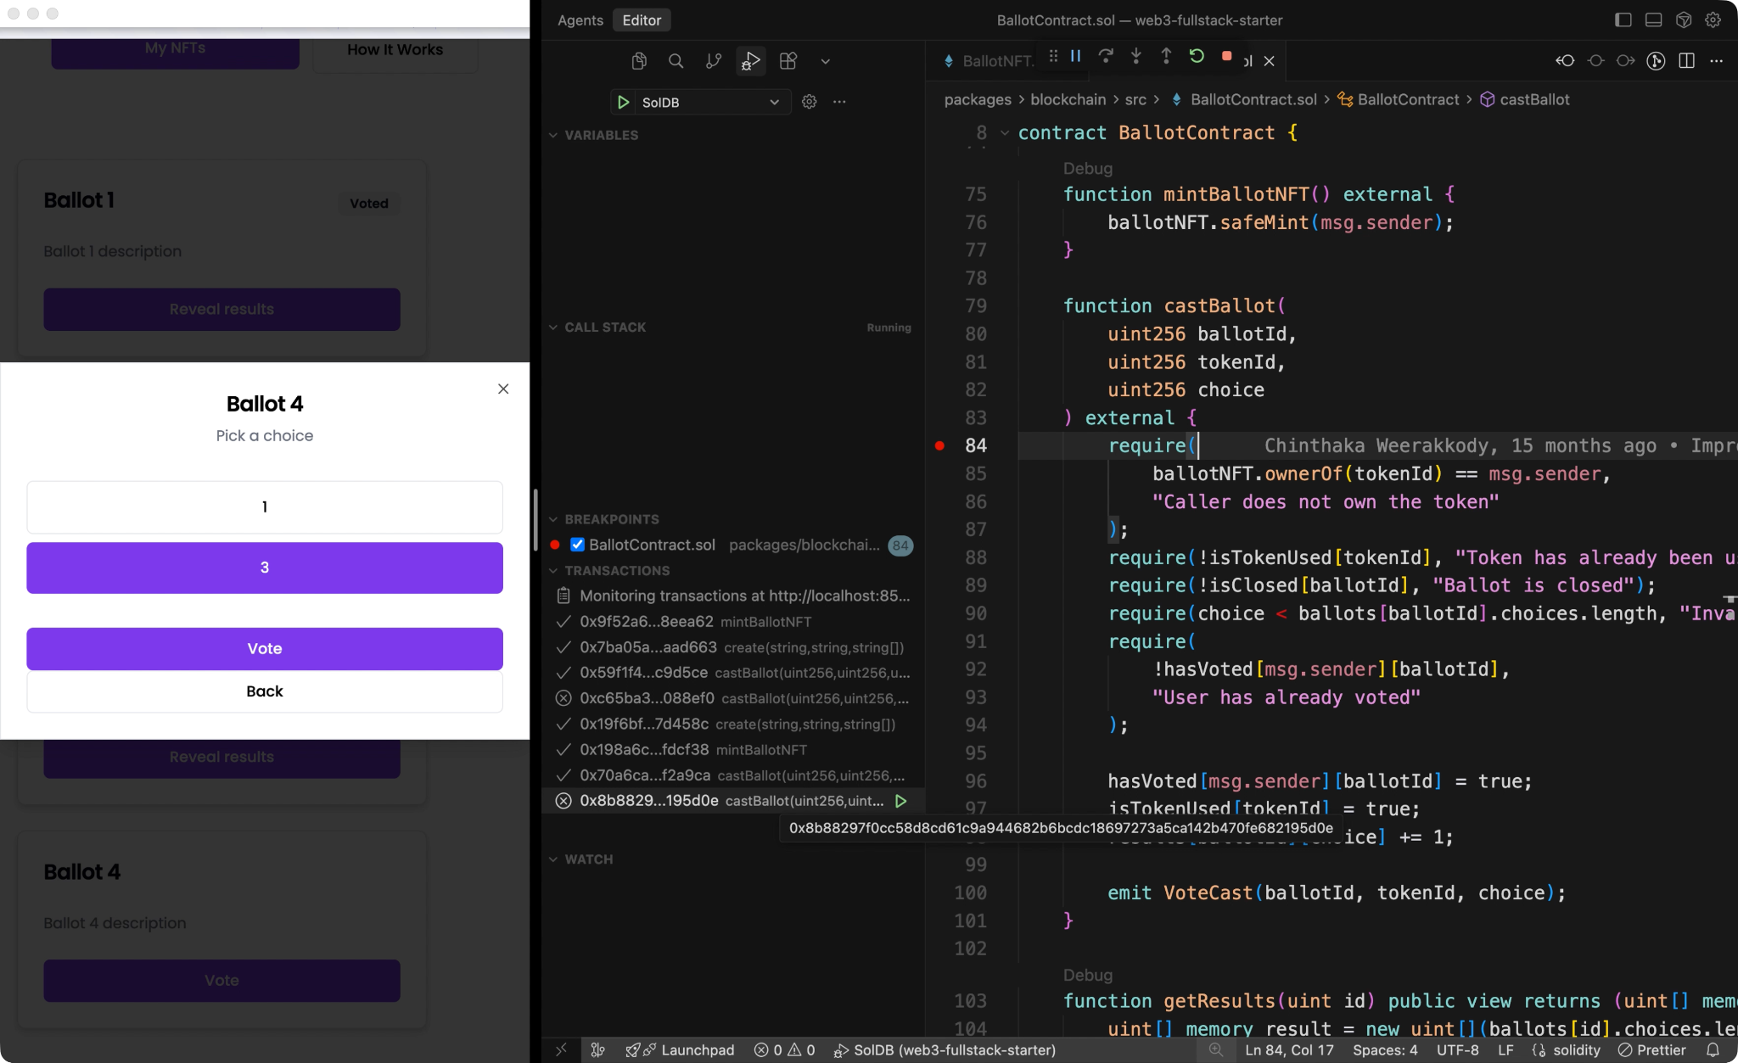

Slide 23
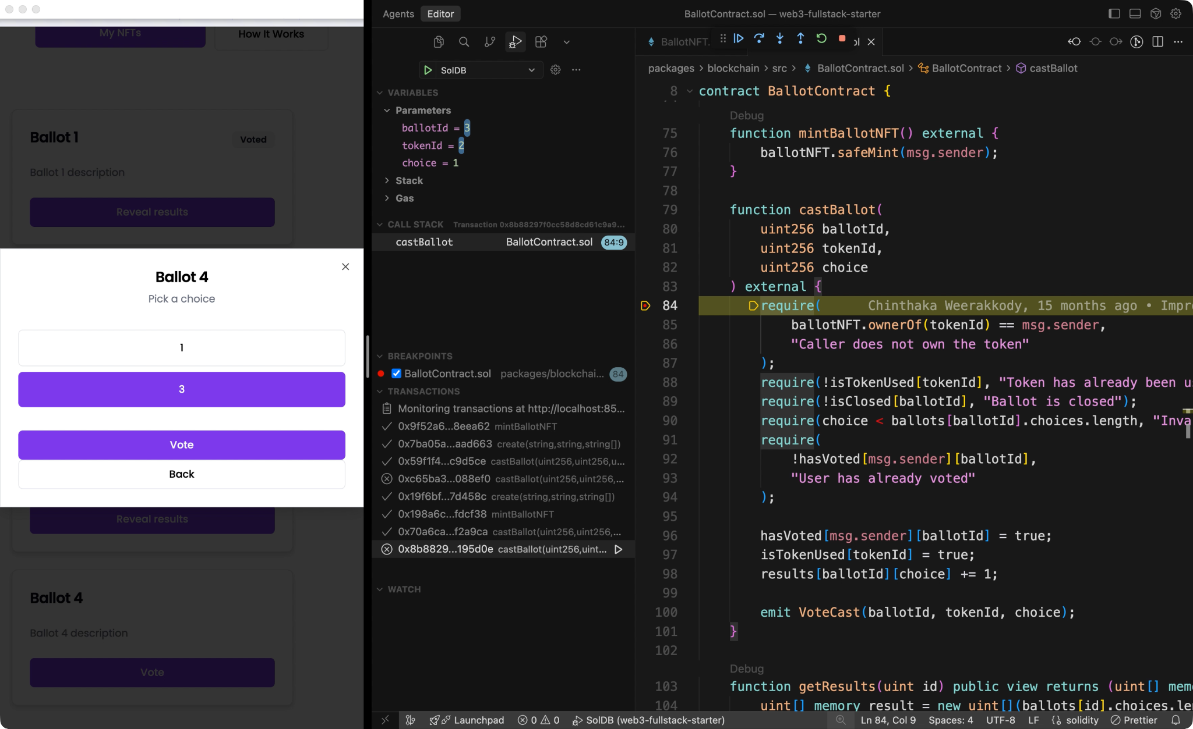

Slide 24
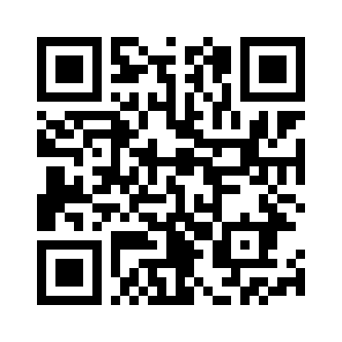
VSCode Debugger for Solidity
Local and Remote Debugging (anvil or custom RPC)
Local Source Code
Remote Source Code via Sourcify

Slide 25

THE BAD
Mappings

Slide 26
HOW DEBUGGERS WORK
Solidity Code
Good Debug Info
Is Critical for Debuggers
Currently Not Great
Compiler
Debugger
Executable
Debug Info
mapping

Slide 27
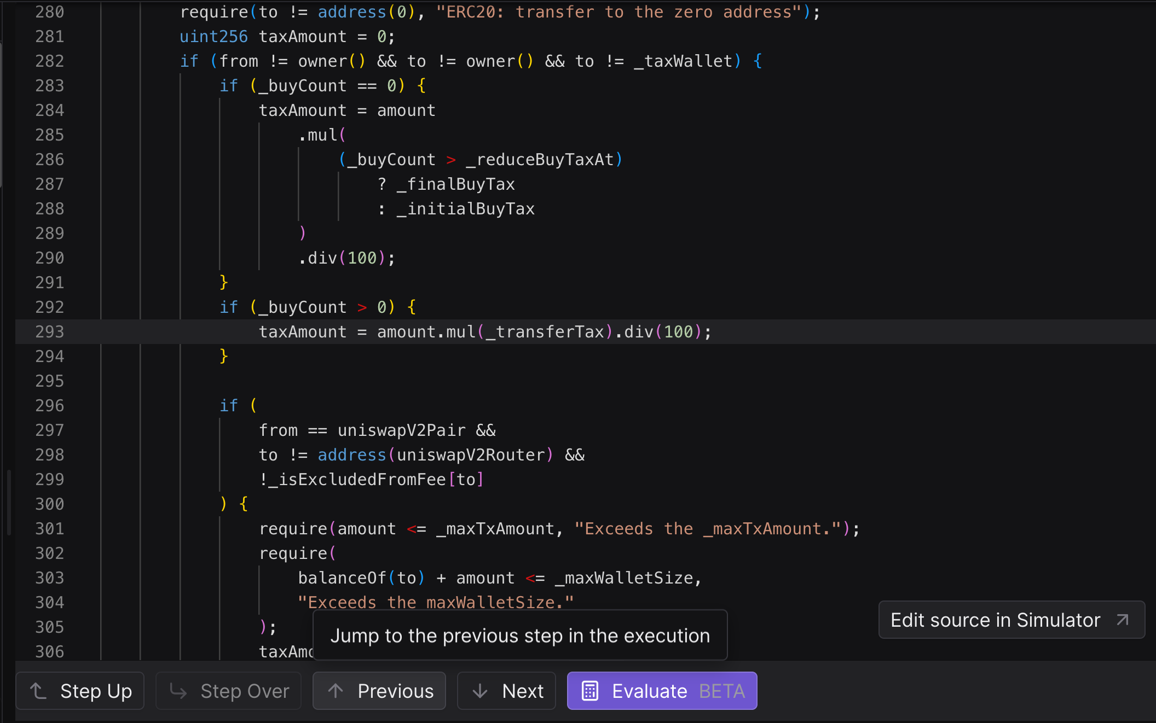

Slide 28
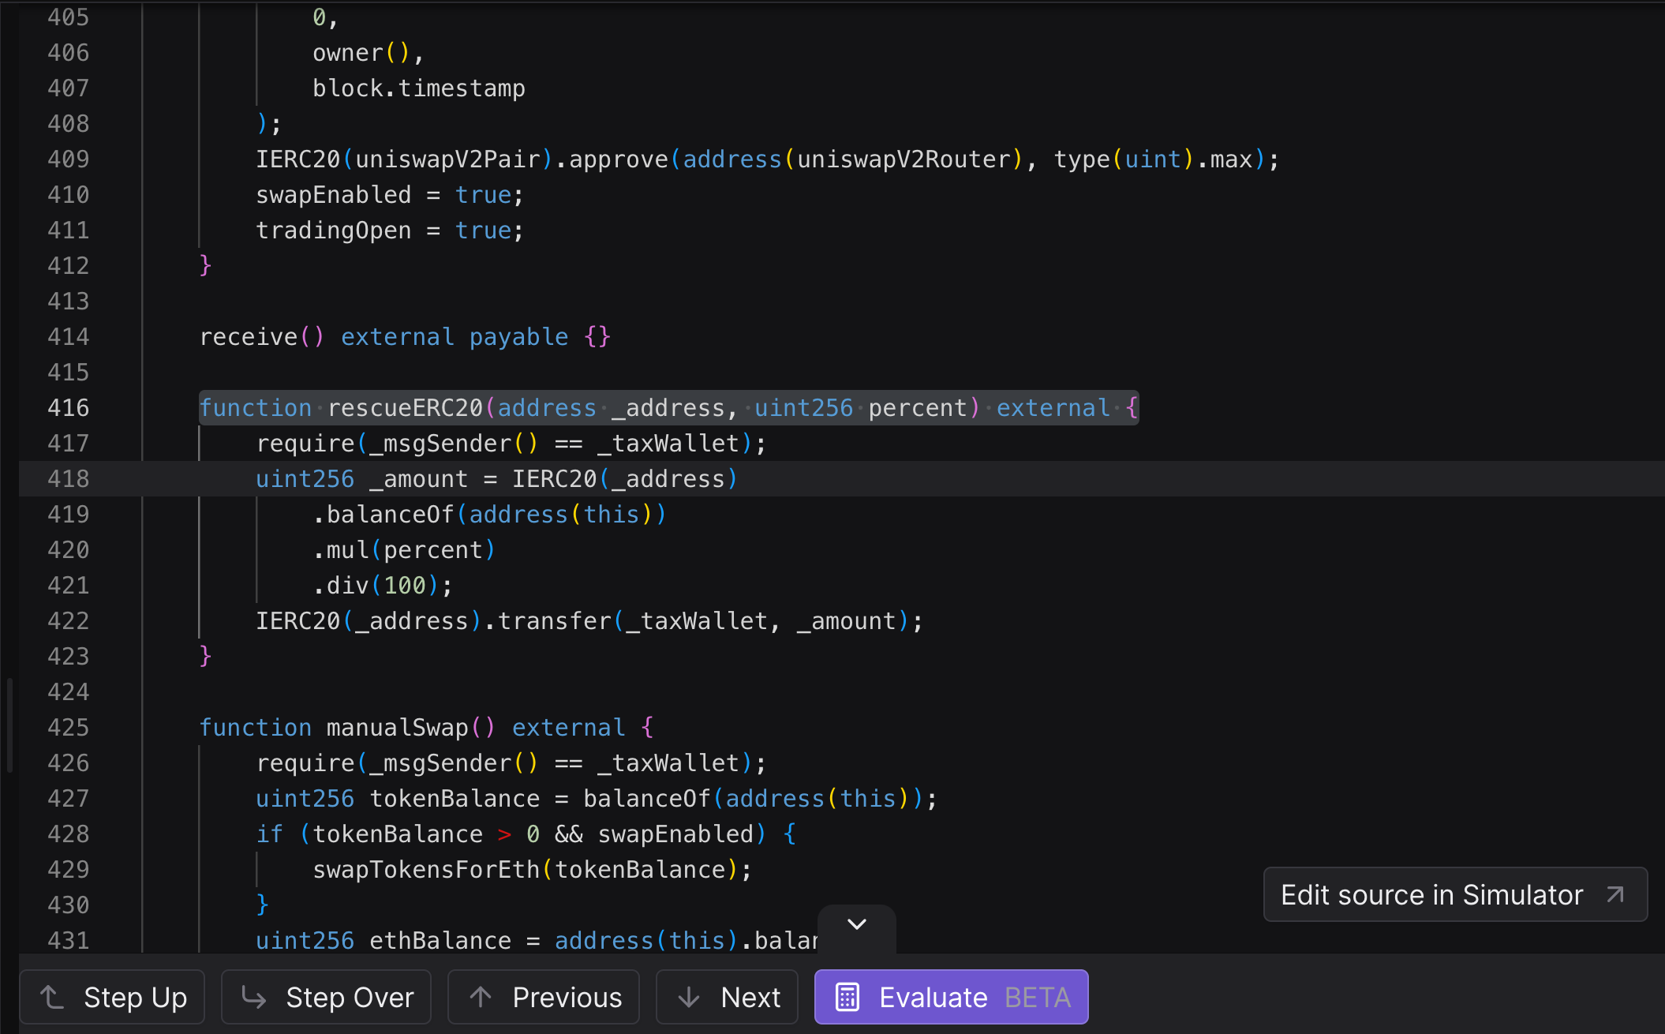

Slide 29
HAVING GOOD DEBUG INFO WILL REQUIRE STRONG COORDINATION ACROSS COMPILER TEAMS
Compilers
Debuggers
solc --via-ir
Debug Info
Tenderly
solc (legacy)
soldb
solar
(ETHDebug)
edb
solx

Slide 30
Can we quantify how Solidity compiler versions differ in debug-info quality?
and build a single KPI for all compilers to aim for…
kinda like rollup stages (0, 1, 2 …)

Slide 31
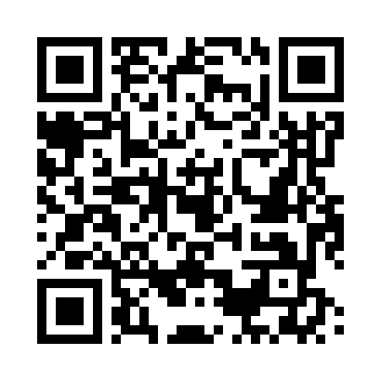
Solidity Compiler Benchmarks
Line Coverage Checks
Variable Location Coverage Checks
Supports solc, solar and solx
Supports multiple compiler versions
CLI-based (automation)

Slide 32
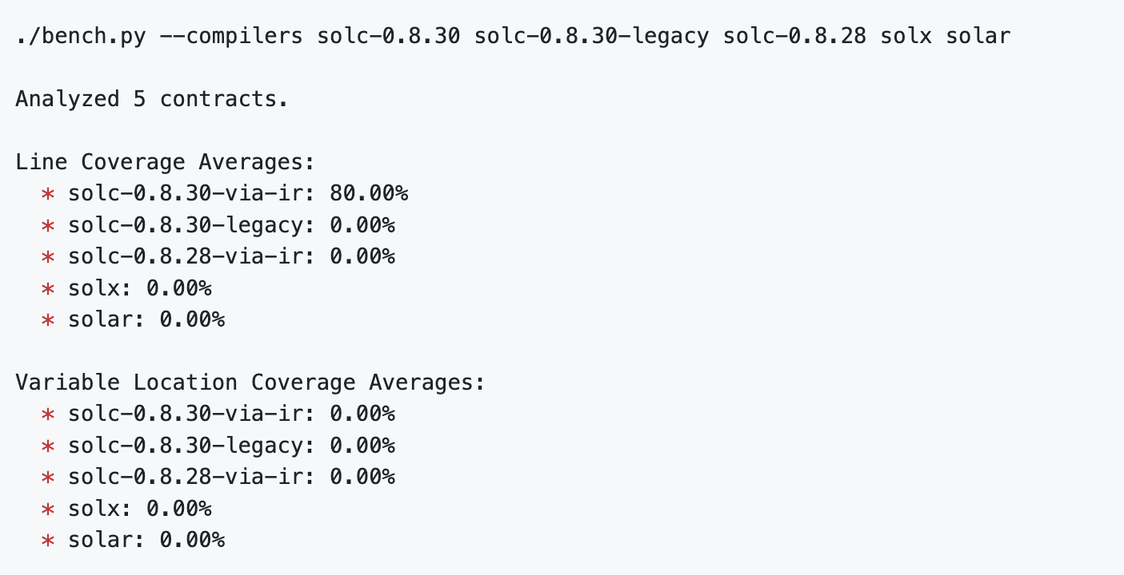
Solidity Compiler Benchmarks

Slide 33
Summary
The community wants to build better debuggers.
Solidity compilers currently emit weak debug info.
Let’s align on one benchmark to track improvements.

Slide 34


Thank You
New Solidity Debugger
Compiler Benchmarks
Get in Touch

